Slide 1

Round Robin topics:
Model Based Capabilities Matrix – Evolution
Model Portfolio Management Guide - Adoption
Al Hoheb (Project Lead), The Aerospace Corporation
Albert.c.hoheb@aero.org
www.incose.org/IW2021

Slide 2
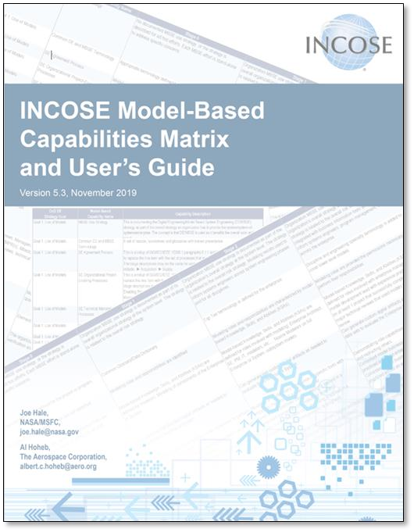
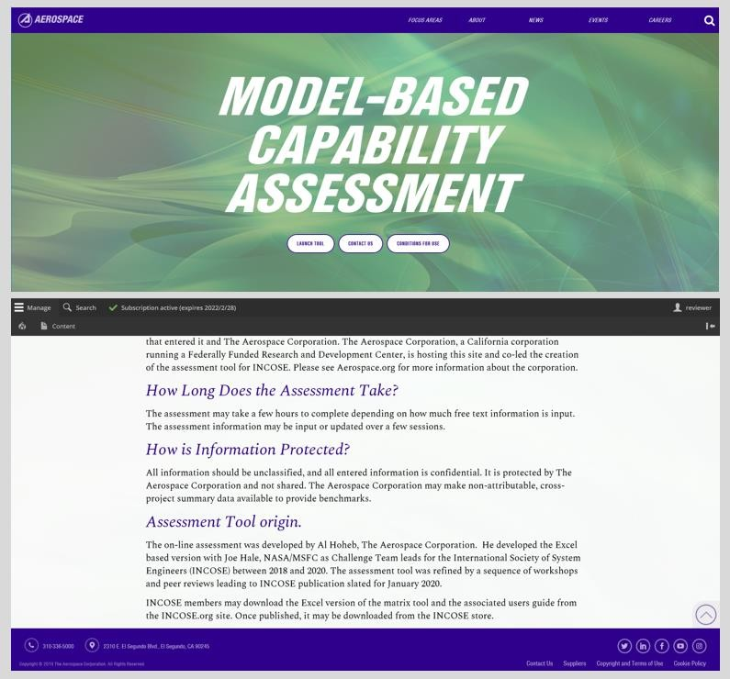
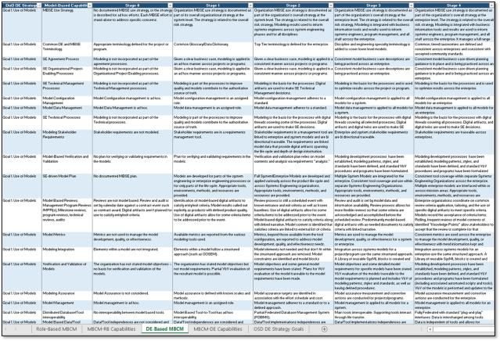
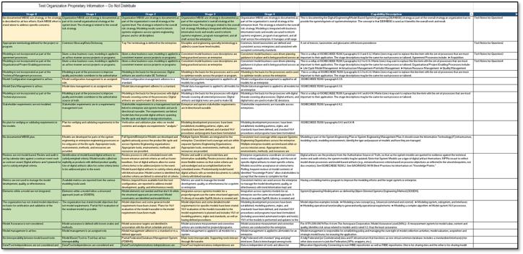
Model-Based Capabilities Matrix Assessments
https://aerospace.org/mbca provides an on-line assessment as a corporate service to anyone for free, we have access to the data for benchmarking
Al Hoheb, Aerospace, Joe Hale, NASA/MSFC (retired), developed and published the Model-Based Capabilities Matrix assessment tool and User’s Guide through INCOSE
Users
Government
Industry
Commercial

Slide 3
Model-Based Capabilities Matrix – Evolution Workshop
The Model-Based Capabilities Matrix (MBCM) and User’s Guide was INCOSE published in January 2020 and are available from the INCOSE Store
The materials have been extensively used since late 2018
Extensively used as-is and also tailored by gov’t and industry
Spawned INCOSE – SERC SE Survey, AFMC Digital Campaign “Digital Maturity Metrics” program for the AF, versions adopted by USN and NASA
After one year of use with the published versions users have a variety of ideas to use and update the materials
Partnered with Michael Russell, The MITRE Corporation, a “super user,” to conduct the workshop
This workshop gathered user input, gather “pro tips” and to determine the need to update the published materials

Slide 4
Model Portfolio Management Guide
The Need
Currently there is no guide or standard that addresses managing a collection of models
Organizations score low on “Model Management” capabilities when assessed by the INCOSE Model-
Based Capabilities Matrix
The SERC SE Survey cited “Model Management” as a significant area of improvement
Acquirers routinely ask for model management work and responding bidders have a range of responses
An interim solution
The Aerospace Corporation wrote the “Model Portfolio Management (MPM) Guide” technical operating report TOR-202-01577, cleared for public release to serve organizations that would like to manage their collection of models and to serve as an solicitation reference document
The TOR was written using the INCOSE style guide for documents
The TOR is already been used as a reference for US government acquisitions
Proposed solution
INCOSE to consider the MPM Guide TOR as the basis of an INCOSE guide
The draft INCOSE Technical Performance Plan provides an approach to develop the INCOSE guide

Slide 5

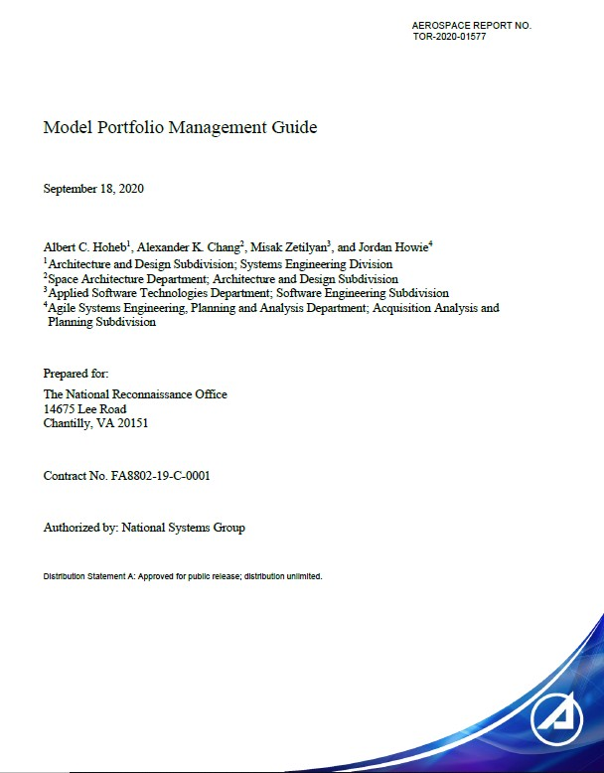
MPM Guide Adoption Workshop Overview
Workshop Organizers
Al Hoheb (Project Lead), The Aerospace Corporation, Albert.c.hoheb@aero.org
Misak Zetilyan, The Aerospace Corporation, misak.zetilyan@aero.org
John Nallon, INCOSE, jfnallon@outlook.com
Workshop Agenda
Welcome, introductions and logistics Overview of the Tools Integration & Model Lifecycle Management (TIMLM) WG
Overview of The Aerospace Corporation MPM Guide document Review of Candidate INCOSE Technical Procedure Plan
Next Steps

